Slide 1
Population Viral Load Measures and A Recent HIV Case at Enumeration Area Level
Farahani¹, M., Radin¹, E., Saito¹, S., Sachathep¹, K., Manjengwa¹, J., Balachandra², S., Low¹, A., Duong¹, Y., Jonnalagadda², S., Patel², H., Voetsch², A., Hladik², W., Hakim², A., Ahmed¹, N., Musuka¹, G., Tippett Barr², B., Wadonda-Kabondo², N. W., Auld², A., Jahn², A., Williams², D., Barradas², D., Payne², D., Bello³, G., Mugurungi⁴, O., Parekh², B., Hoos¹, D., Justman¹, J.
1: ICAP at Columbia University; 2: U.S. Centers for Disease Control and Prevention (CDC); 3: ITECH-Malawi; 4: Zimbabwe Ministry of Health and Child Care
Notes:
Good afternoon! Ladies and gentlemen, on behalf of my colleagues in PHIA projects, I am going to present our study on the association of various viral load measures and a recent HIV infection at enumeration area level

Slide 2
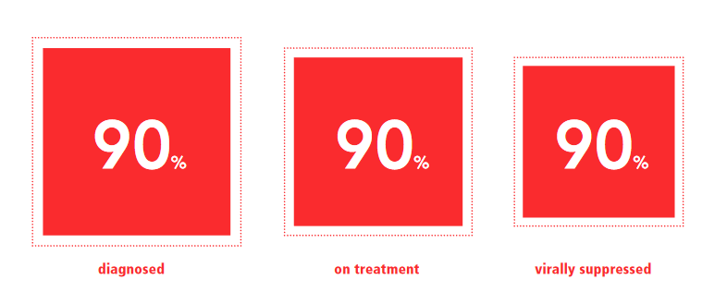
UNAIDS Goal and Targets
Goal: To end the AIDS epidemic by 2030.
Targets: by 2020
More PLHIV on ART
Lower plasma VL
Lower HIV incidence
Notes:
UNAIDS pursue the ambitious goal of ending the AIDS epidemic by 2030. To achieve this goal, UNAIDS set a three-part target, 90-90-90 by 2020.
The underlying rationale for these targets is that HIV viral load level in blood and semen is the main determinant of HIV transmission. Therefore reduction of the viral load in infected individuals reduces the chance of HIV transmission.

Slide 3
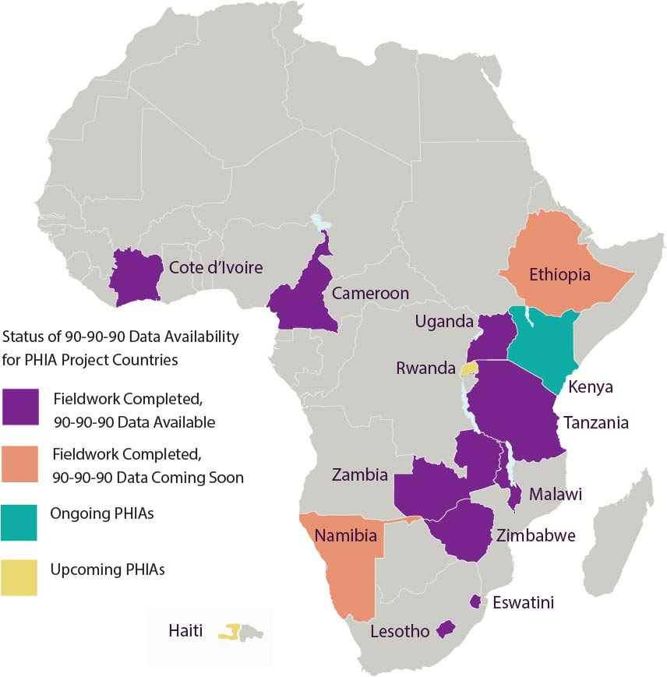
Encouraging Results Towards 90-90-90
Encouraging initial findings from the Population-based HIV Impact Assessment (PHIA) surveys in 9 countries.
VLS among those on ART range from 75.9 in Cote d’Ivoire to 91.9% in eSwatini (Swaziland).
Notes:
Population HIV Impact Assessment or PHIA surveys, launched in 2014, are HIV focused, household-based, nationally representative, cross-sectional surveys of adults and children in 14 high-burden countries. Initial findings from the PHIA surveys in 9 countries reveals encouraging results regarding the 90-90-90 targets. For example, VLS among those on ART range from almost 76% in Cote d’Ivoire to almost 92% in eSwatini (Swaziland).
However, the overall question remains as to whether achieving these targets can be translated to a reduction in HIV transmission and, in turn, to a lower incidence rate, and eventual containment of the epidemic.

Slide 4
Concerns for Internal Validity in Early Studies
Many studies used different measures of aggregate VL to evaluate the ART programs and as a proxy for HIV incidence since 2009
Limitations and biases in previous studies:
  Ecological fallacy
  Sampling bias
  Missing data
  Not including HIV prevalence in the model
  Only those with a known HIV status were included
Miller, W. C., et al (2013). "Community viral load as a measure for assessment of HIV treatment as prevention." The Lancet Infectious Diseases 13 (5): 459-464
Notes:
Since 2009 when the first reports of community viral load were published, many studies have used aggregate measurement of viral load to evaluate the treatment programs and as a proxy for HIV incidence. Many of these studies had several known limitations and biases that were causes of concern.

Slide 5
Concerns for External Validity in Recent Studies
Recent studies showed population VL and prevalence of viremia are correlated with HIV incidence
Hard to extrapolate to the general population:
  Certain locations (Rural KwaZulu-Natal, South Africa; 22 cities in India)
  Populations (PWID and MSM)
Solomon, S. S., et al (2016). "Community viral load, antiretroviral therapy coverage, and HIV incidence in India: a cross-sectional, comparative study." The Lancet HIV 3(4): e183-e190.
Tanser, F., et al (2017). "Effect of population viral load on prospective HIV incidence in a hyperendemic rural African community." Science translational medicine 9(420): eaam8012.
Notes:
Two recent studies addressed those concerns and showed that the population VL and/or prevalence of viremia were correlated with HIV incidence. However, because one study used data exclusively from people who inject drugs and men who have sex with men in 22 cities in India, and the other from prospective cohorts only in rural kwazulu-Natal, in South Africa,, the results could not be readily extrapolated to the general population. To date, no studies have directly measured the strength of association between VL aggregate measures in small communities and occurrence of a recent HIV infection at a national level.

Slide 6
Research question
Is there an association between population viral load and viral load suppression and the probability of at least one recent HIV-1 infection in the surveys’ smallest geographic sampling unit (an enumeration area)?
Notes:
Taking advantage of the unique opportunity we had with the PHIA data, we set out to answer the following question: Is there an association between population viral load and viral load suppression and the probability of at least one recent HIV-1 infection in the surveys’ smallest geographic sampling unit ( or an enumeration area)?

Slide 7
Methods
Nationally representative, cross-sectional data from PHIA surveys in Zimbabwe, Malawi, and Zambia.
Two-stage stratified cluster sample,
  1st : EAs from the latest census
  2nd : randomly selected a sample of households in each EA
Graphic compliment to UN Statistics Division
Notes:
We used nationally representative, cross-sectional data from the PHIA surveys implemented in Zimbabwe, Malawi, and Zambia. The surveys used a two-stage stratified cluster sample design, where the first stage selected enumeration areas from the latest census available in the country. The second stage randomly selected a sample of households in each enumeration area. In this study we aggregated the data at the level of enumeration area. In the census parlance, an enumeration area is the smallest geographic unit which groups a number of households together for convenient counting purposes.

Slide 8
Enumeration Area Sample Size
Total data collected: 1,510 EAs across the three surveys
Included in this study: 1,374 EAs (91%) with at least one HIV+ adult, consenting to an interview and blood draw.
 | Urban | Rural | Total
Zimbabwe | 155 | 344 | 499
Malawi | 160 | 340 | 500
Zambia | 194 | 317 | 511
Total of 58,366 adults aged 15-59 years
Notes:
In 2015 and 2016, data were collected from a total of 1,510 EAs in three countries. In this analysis, we included data from 1,374 EAs that had at least one HIV-infected adult, consenting to an interview and blood draw. On average, there were 28 households per EA. We used the blood samples from a total of 58,366 adults aged 15-59 years resided in these EAs.

Slide 9
Number of recent cases
Number of recent HIV cases at EAs | Malawi | Zambia | Zimbabwe | Total
0 | 405 (93.5%) | 406 (90.6%) | 463 (94.1%) | 1,274 (92.8%)
1 | 27 (6.2%) | 40 (8.9%) | 27 (5.5%) | 94 (6.9%)
2 | 1 (0.2%) | 2 (0.5%) | 2 (0.4%) | 5 (0.4%)
Total | 433 | 448 | 492 | 1,373
Notes:
We employed a combination of the HIV-1 Limiting Antigen-Avidity enzyme immunoassay and viral load to distinguish recent from long-term infection
Among the 1,373 EAs, almost 93% did not have a recent case of HIV, 7% had one recent case and less than half a percent (or only 5 EAs) had 2 recent HIV cases.

Slide 10
Definitions of Viral Load Aggregate Measures
Population VL: the arithmetic mean of log₁₀ VL in all PLHIV in the EA, irrespective of whether they were aware of HIV status
Unaware VL: the arithmetic mean of log₁₀ VL in individuals with HIV in an EA unaware of their HIV status
In-care VL: the arithmetic mean of log₁₀ VL of all HIV-positive persons in-care
Prevalence of viremia: the prevalence of individuals with HIV in the EA with HIV RNA >1000 c/mL .
Notes:
We calculated various viral load measures as codified by the US Centers for Disease Control and Prevention (CDC) and other groups. we computed the arithmetic mean of log10 for all the viral load measures. For Population VL, we included ALL HIV infected individuals in the EA; For Unaware viral load, we included only the HIV infected individuals unaware of their HIV status, and for in-care viral load, we included people reported to be engaged in care. Lastly, we defined prevalence of viremia as the prevalence of HIV-infected individuals at the EA with HIV RNA more than 1,000 copies per milliliter.

Slide 11
Summary Statistics
 | Median (IQR)
Median age of the female population at the EA | 31.0 (29-33)
Median age of the male population at the EA | 30.7 (29-33)
Proportion of people ever tested HIV at the EA | 77% (71-82)
HIV prevalence at the EA | 14% (9-20)
Prevalence of awareness of HIV status among PLHIV | 75% (57-91)
ART coverage among PLHIV | 67% (50-72)
Prevalence of VLS among PLHIV | 67% (50-83)
Notes:
Median age of both men and women at EA-level was 31. In more than half of the EAs, 77% or more of the adult population were tested for HIV.
Median HIV prevalence at EA-level was 14%.
In half of the EAs, 75% or more of all HIV infected people knew about their HIV infection. In these EAs, median prevalence of ART coverage and viral load suppression among people living with HIV was 67%.

Slide 12
Viral Load Measures
 | Mean | Std. Err. | [95% CI]
Mean log10 VL of those on ART | 0.66 | 0.03 | 0.61 - 0.71
Mean log10 VL of those unaware of HIV status | 2.66 | 0.06 | 2.43 – 2.69
Mean log10 Population VL | 1.88 | 0.04 | 1.79 – 1.97
Prevalence of viremia > 1000 c/mL | 36% | 0.06 | 35 - 37
Notes:
As expected, VL of those on ART was the lowest and that of the people who were not aware of their HIV status was the highest. On average, population viral load across EAs in log10 scale was 1.9. Defining viremia as 1000 copies of HIV RNA per ml, prevalence of viremia across EAs was 36% on average. Testing alternative HIV RNA cutoff points for viremia in our sensitivity analysis, we did not find any considerable differences when the cutoff points changed.

Slide 13
Correlation Between PVL/Unaware VL and A Recent HIV Case
Notes:
We used logistic regression adjusted for EA-level variables, such as HIV prevalence, population size and mean age of the female population, to estimate the probability of one recent HIV-1 infection. These graphs illustrate the adjusted predicted probability of a recent HIV infection at EA-level at various VL levels. In all graphs, the Y axis indicates the probability of having at least one recent HIV case. The X axis on the graphs from left to right shows mean log10 of population viral load, unaware viral load and in-care VL. You can see, as the Population VL, or unaware VL increases, the probability of having a recent HIV infection at EA-level increases as well. We did not find a statistically significant correlation between in-care VL and the occurrence of a recent HIV infection at an EA.

Slide 14
Correlation Between 90-90-90 Indicators and A Recent HIV Case
Notes:
These graphs show that the three indicators of 90-90-90, namely prevalence of HIV diagnosis, ART coverage and VLS at EA-level, are inversely correlated with the occurrence of a recent case of HIV infection at EA-level. The three indicators were highly correlated at EA level. For example, the correlation coefficient for prevalence of HIV awareness and ART coverage at EA level was 0.83 and for ART coverage and prevalence of VL suppression was 0.70. As a result, it seems that all three indicators are equally impactful on predicting the probability of having a recent infection at the EA; but the effect diminishes as the prevalence of each indicator increases.

Slide 15
Interpretation
Half a log higher in the mean log of PVL increases the predicted probability of having a new HIV case by 13%
When prevalence of VLS rises from 40% to 60%, the predicted probability of new HIV infection at enumeration area level drops by 26%.
Notes:
In other words, half a log rise in the mean log of PVL increases the predicted probability of having a new HIV case by 13%. Or, for example, when the prevalence of VLS changes from 40% to 60%, the predicted probability of a recent HIV infection at EA-level drops by 26% .

Slide 16
Conclusion
We found a strong association between PVL and VLS prevalence with recent HIV-1 infection at the EA level in three southern African countries with generalized HIV epidemics.
These results suggest expanding and maintaining high levels of VLS may be key to HIV epidemic control in these three countries.
Notes:
In conclusion We found a strong association between PVL and VLS prevalence with the occurrence of a recent HIV-1 infection at the EA level in three southern African countries with generalized HIV epidemics. These results suggest expanding and maintaining high levels of VLS may be key to HIV epidemic control in these three countries.

Slide 17

Acknowledgements
CDC - Malawi
Andrew Auld
Geoffrey Chipungu
Evelyn Kim
Danielle Payne
Nellie Wadonda-Kabondo
Christine West
CDC-Zimbabwe
Beth Barr
Elizabeth Gonese
Amy Herman-Roloff
Evonne (Amaka) Nwankwo-Igomu
Sheetal Patel
Leala Ruangtragool
Norah Sukutayi Vere
CDC-Zambia
Danielle Barradas
Haotian Cai
Sarah Guagliardo
Sundeep Gupta
Kathy Hageman
Stanley Kamocha
Clement Ndongmo
Margaret Riggs
CDC-Atlanta
Arnesler Coleman
Sehin Birhanu
Kristin Brown
Melissa Cates
Mervi Detorrio
Trudy Dobbs
Linda Fleming
Avi Hakim
Wolfgang Hladik
Keisha Jackson
Sasi Jonnalagadda
Steven Kinchen
Kathryn Lupoli
Stephen McCracken
Carin Molchan
Carole Moore
Christopher Murrill
Katina Pappas-Deluca
Bharat Parekh
Jacqueline Rurangirwa
Tonya Ross Walker
Vedapuri Shanmugam
Katrina Sleeman
Paul Stupp
Daniel Williams
Floris Wray-Gordon
Daniel Yavo
Ernest Yufenyuy
Janet Burnet
ICAP – New York
Mark Fussell
Elizabeth Radin
Suzue Saito
Andrea Low
Stephen Delgado
Elizabeth Gummerson
Karam Sachathep
Neena Philip
Jill Pace
Rita Sondengam
Natasha McLeod
Noelle Esquire
Sally Findley
Josh Krieger
Olga Crowley
Yen Pottinger
Katie Johnson
Stephen Arpadi
Joseph Elias
Chelsea Solmo
Natazia Fistrovic
Nahima Ahmed
Kiwon Lee
Hannah Chung
Melissa Metz
Rachel Bray
Michael Cooney
Lauren Williams
ICAP in Zimbabwe
Godfrey Musuka
Givemore Chundu
Hazel Dube
Julius Manjengwa
Desmond Maminimini
Rosemary Muchengeti
Vusumuzi Maliwa
ICAP in Zambia
Kumbutso Dzekedzeke
Darius Simbeye
Casco Mubanga
Mulenga Katongo
Tepa Nkumbula
Robyn London
Martin Katongo
James Shamamba
Theresa Sikateyo
ICAP in Malawi
Stephen Nkoka
Christine Chung
Huxley Kanyongoloka
Sungani Zidana-Ndovi
Khozgani Mzumara
Richard Mmanga
Helecks Mtengo
South Africa Regional Office
Blanche Pitt
Charles Wentzel
Bright Phiri
Herbert Longwe
Takura Kupamupindi
Belete Tegbaru Erkyhun
Pule Mphohle
Oliver Murangandi
Government of Zimbabwe
Ministry of Health and
Child Care
Owen Mugurungi
Gibson Mhlannga
Mutsa Mhangara
Tsitsi Apollo
Agnes Mushavi
Getrude Ncube
National AIDS Council (
Zimbabwe)
Tapuwa Magure
Amon Mpofu
Ministry of Health, Zambia
Chipalo Kaliki
Crispin Moyo
National Statistics Office (NSO), Malawi
J. Ndawala
National AIDS Commission,
Malawi
Blackson Matatiyo
ZIMSTAT
Godfrey Matsinde
Aluwisio Mukavhi
Nyaradzai Ngonyama
Langton Chikeya
BRTI
Peter Mason
Shungu Munyati
Lovemore Gwanzura
Salome Manyau
Lancet Zimbabwe
Charles Muronda
Grace Ramhewa
Central Statistical Office,
Zambia
Nchimunya Nkombo
Iven SIkanyiti
Chola Nakazwe Daka
Palver Sikanyiti
Chibesa Musamba
Tropical Diseases Research Centre, Zambia
Webster Kasongo
University Teaching Hospital, Zambia
Gina Mulundu
University of Zambia
Emmanuel Tembo
Jacob Malungo
Nkuye Moyo
Ministry of Health, Malawi
Frank Chimbwandira
George F. Bello
Andreas Jahn
Sikhona Chipeta
Mathews Kagoli
C. Mwansambo
Sheila Bandazi
D. Kabambe
R. Mwenda
Blantyre Health Research and Training Trust (BHRTT)-Johns Hopkins University Laboratories
N. Kumwenda
Elizabeth Kampira
Centre for Social Research, Malawi
A. Munthali
John Kadzandira
This project is supported by the U.S. President’s Emergency Plan for AIDS Relief (PEPFAR) through CDC under the terms of cooperative agreement #U2GGH001226. The contents are the responsibility of ICAP and do not necessarily reflect the views of the United States Government.
The mark "CDC" is owned by the US Dept. of Health and Human Services and is used with permission. Use of this logo is not an endorsement by HHS or CDC of any particular product, service, or enterprise.
Notes:
I would like to take a moment to thank all my friends and colleagues at ICAP, Westat, CDC, ministries of health and all other colleagues in PHIA projects for their hard work in data collection and their contribution to the analysis of the data. This would not have been possible without all your excellent work and patience.
Thank you for your attention and I would be happy to answer your questions.

